Slide 1
PARTS OF SPEECH

Slide 2
Words are divided into different kinds or classes called Parts of speech, according to their use in a sentence. The parts of speech are eight in number:-
Noun
Adjective
Pronoun
Verb
Adverb
Preposition
Conjunction
Interjection

Slide 3
NOUNS
A NOUN is a word used as the name of a person, place, animal or thing. For example:
Person – Ali, boy, girl, Ria, teacher etc.
Place - Delhi, school, Mumbai, hospital etc.
Animal- lion, peacock, giraffe, sparrow etc.
Thing - books, bag, pencil, bottle etc.

Slide 4
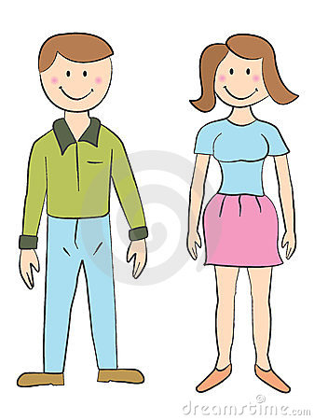
GENDERS
Living beings are of either the male or the female sex.
A noun that denotes a male is said to be the MASCULINE gender. For eg: boy, king, man, lion etc.
A noun that denotes a female is said to be FEMININE gender. For eg: girl, queen, woman, lioness etc.
MASCULINE FEMININE
man woman
bull cow
tiger tigress
uncle aunt
poet poetess

Slide 5
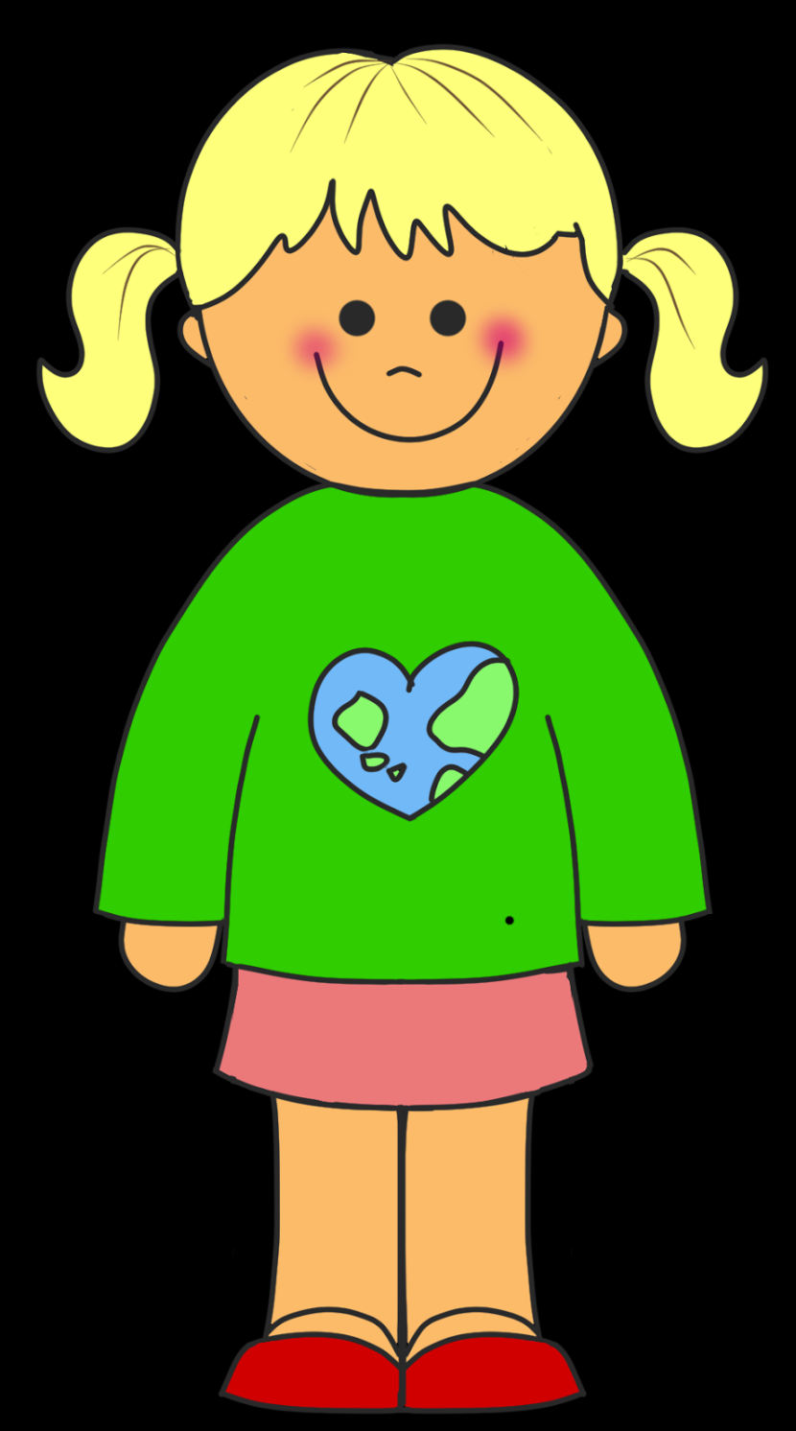
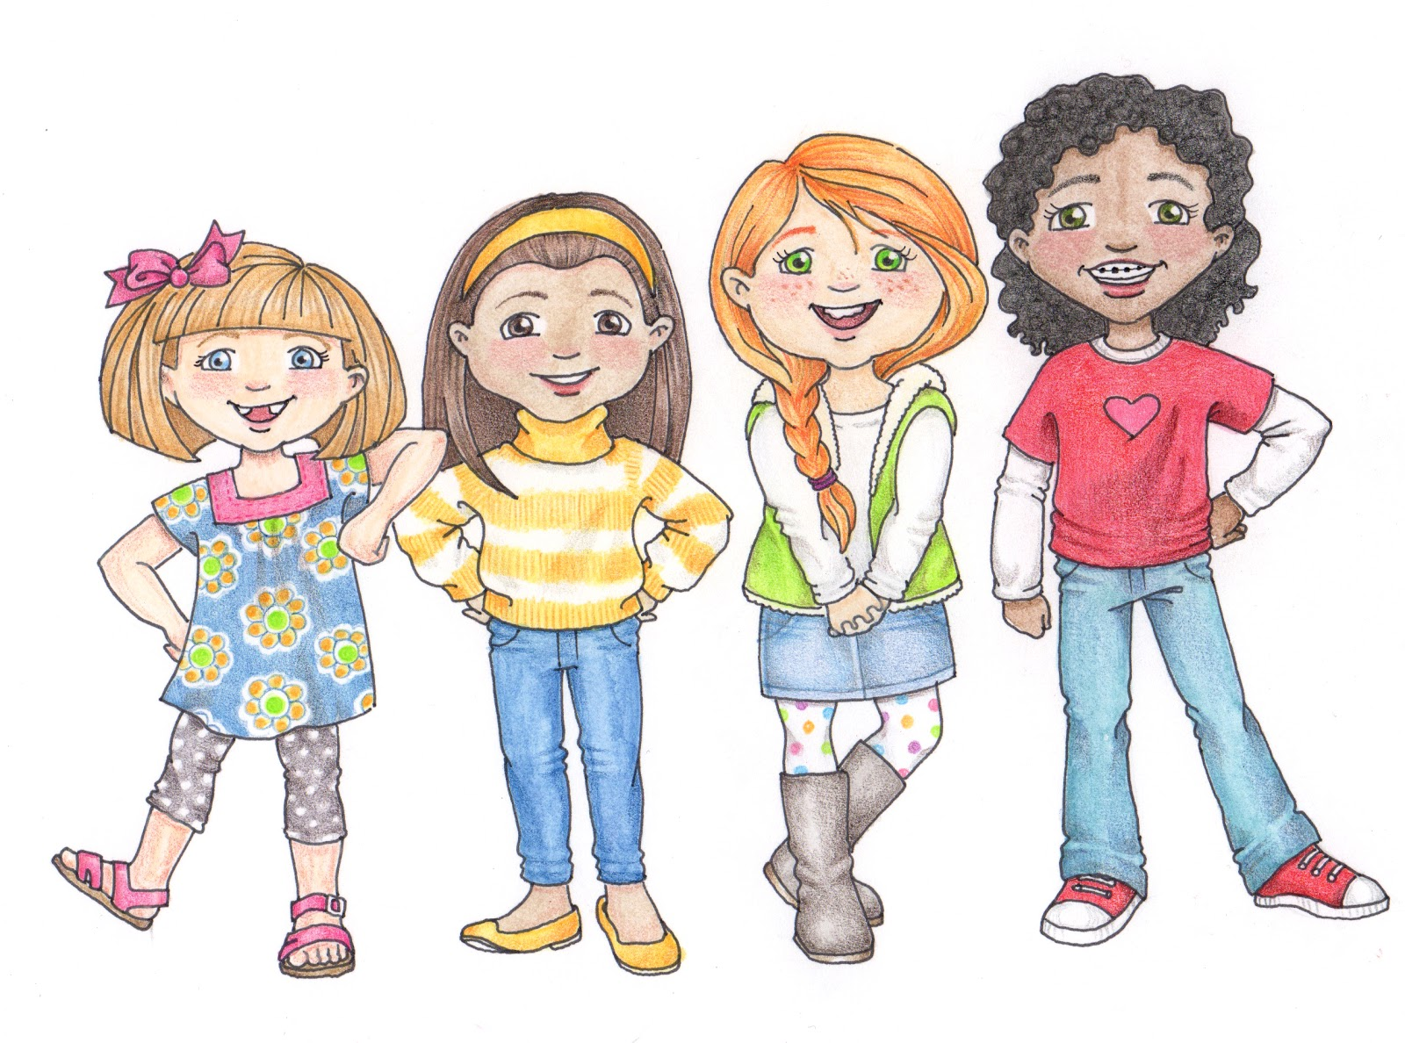
PLURALS
A noun that denotes one person, animal or thing, is said to be SINGULAR. For eg: boy, cow, tree, book, pen etc.
A noun that denotes more than one person, animal or thing, is said to be PLURAL. For eg: boys, cows, trees, books, pens etc.
The plural of nouns is generally formed by adding –s to the singular.
pen - pens
cow - cows
girl - girls

Slide 6
b) For nouns ending with ss, sh, ch, x and o we add es to make their plural.
class - classes fox- foxes
brush- brushes mango- mangoes
match- matches
c) For nouns where y follows a consonant, their plural is formed by replacing y with i and adding es.
baby - babies
story - stories
d) For nouns where y follows a vowel, their plural is formed by adding s.
day - days
e) For nouns ending with f or fe, we make their plural by replacing f or fe with v and adding es.
leaf - leaves
thief- thieves
life- lives
wife- wives

Slide 7
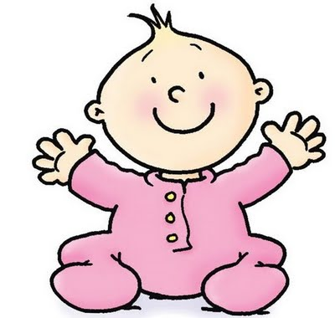
ADJECTIVES
A word that describes a person, place, animal or thing is called a describing word. Describing words are called ADJECTIVES. For eg: tall, small, hot, funny, happy etc. are adjectives.
Colours are also describing words. For eg: red dress, green grass, yellow flower etc.
EXAMPLES: The sun is yellow.
I like ripe mangoes.
Ajay is a smart boy.
The pillow is soft.
My mother is a kind lady.

Slide 8
PRONOUNS
Words that are used in place of nouns are called PRONOUNS.
When we talk about one we use the pronouns I, me, you, he, she, it, her, him.
When we talk about more than one we use the pronouns we, us, they, them.
The pronoun ‘you’ is used for one person as well as more than one person.
EXAMPLES: Kumar is going to the market. He is going to buy a book.
Look at the stars. They are twinkling.
Geeta and Babita say that they like to play cricket.
Mary has a little lamb. It follows Mary everywhere.
You are a good dancer.

Slide 9
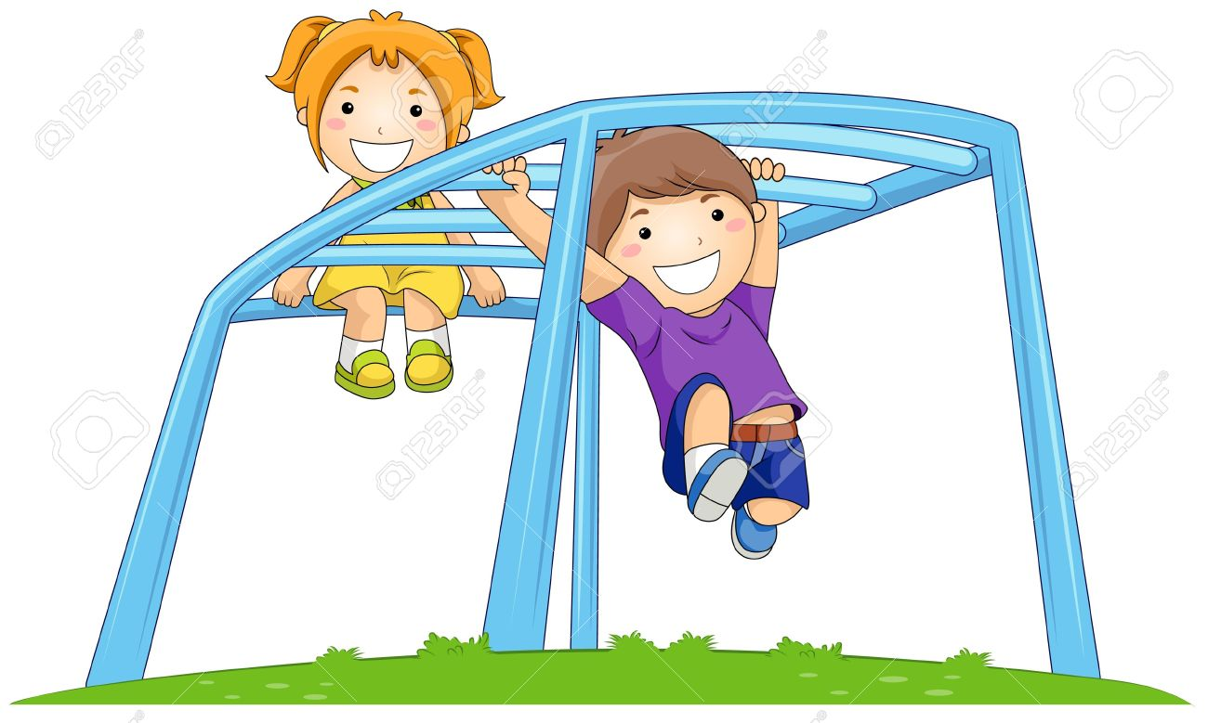
VERBS
Words that tell us what a person, animal or thing does are called VERBS.
Verbs show action, so they are also called action words or doing words. For eg: run, read, eat, sleep, play, throw, give, clap etc. are action words or verbs.
EXAMPLES: I play in the park.
The sun shines.
They walk to school.
I write with a pencil.
He likes to eat Chinese.
Stars twinkle in the sky.

Slide 10
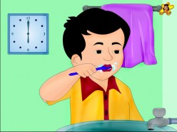
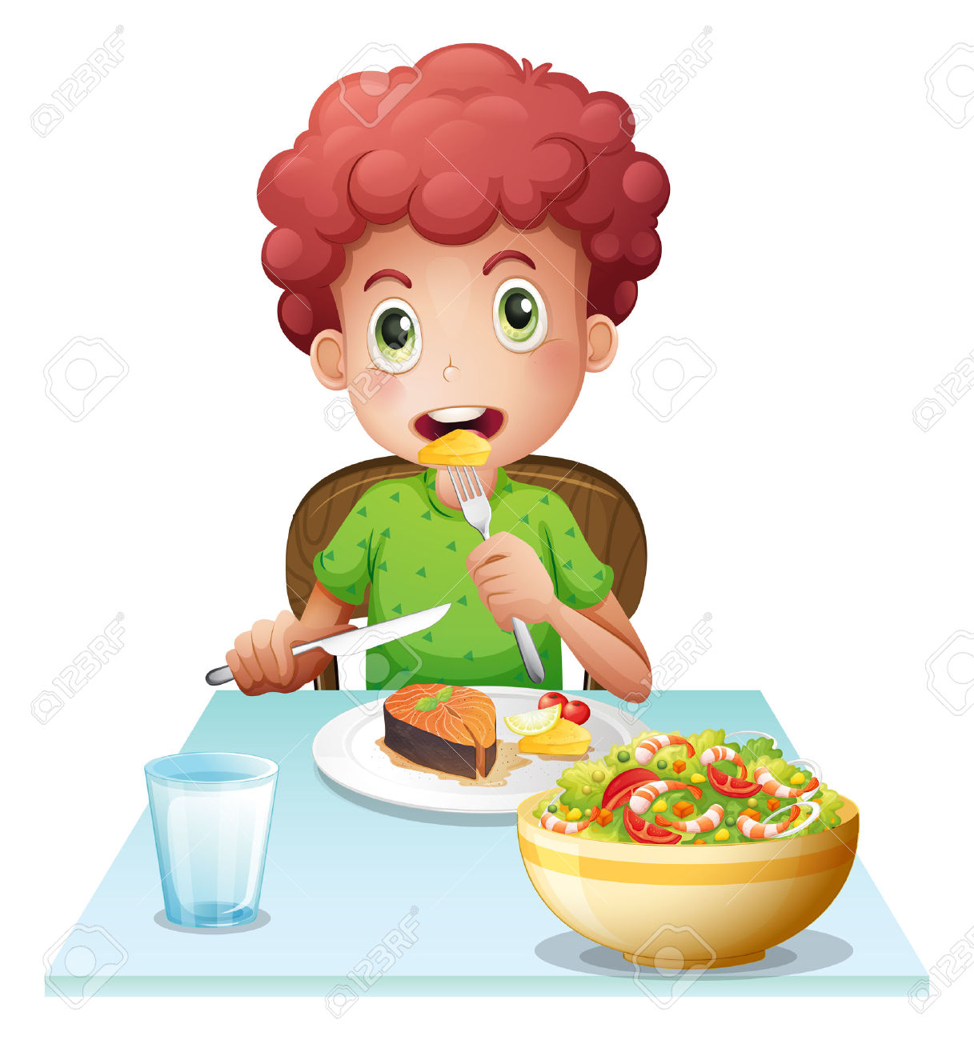
When we talk about an action that is taking place we use ‘ing’ words. For eg: singing, eating, reading, baking, talking, climbing etc.
EXAMPLES: Amit is swimming.
Raman is brushing his teeth.
Salma is running.
Rita is reading a book.
The baby is sleeping.
Pawan is eating food.

Slide 11
Use of is, am and are
We use is, am and are when we talk about something that is happening.
a) We use is or am when we talk about one person or thing.
EXAMPLES: I am seven years old.
Priya is an artist.
The book is on the table.
b) We use are when we talk about two or more people or things.
EXAMPLE: The birds are flying.
The boys are playing.
Those flowers are pretty.

Slide 12
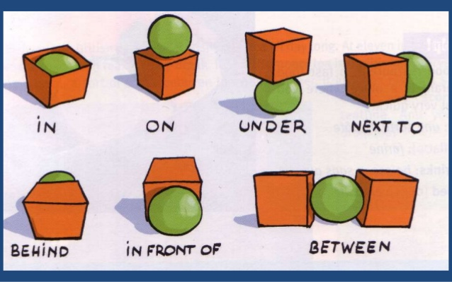
PREPOSITIONS
Words that tell us where a person, animal, place or thing is are called PREPOSITIONS. For eg: in, on, under, behind, near, between, in front, over are prepositions.
EXAMPLES: The cake is on the table.
The ball is between Arun and Aman.
The bird is sitting on the branch.
The boy is hiding behind the door.
The ice- cream is in the cup.

Slide 13
CONJUNCTIONS
Words that are used to join words and sentences are joining words. Joining words are called CONJUNCTIONS. For eg: and, but, or are conjunctions.
EXAMPLES: I like bread and butter.
Ram likes apples but Sam likes grapes.
Mini ate her breakfast and went to school.
Rohit is fat but Ajay is thin.

